Slide 1

INT247 Machine Learning Foundations
Lecture #4.1
Ensemble learning, Bagging and AdaBoost classifier

Slide 2
Learning with ensembles
The goal behind ensemble methods is to combine different classifiers into a meta-classifier that has a better generalization performance than each individual classifier alone.

Slide 3
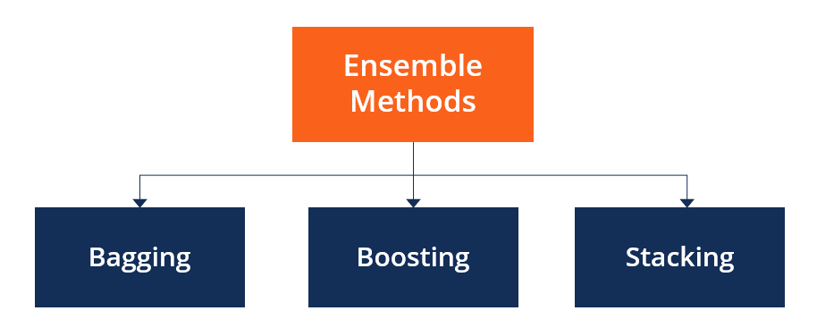

Slide 4
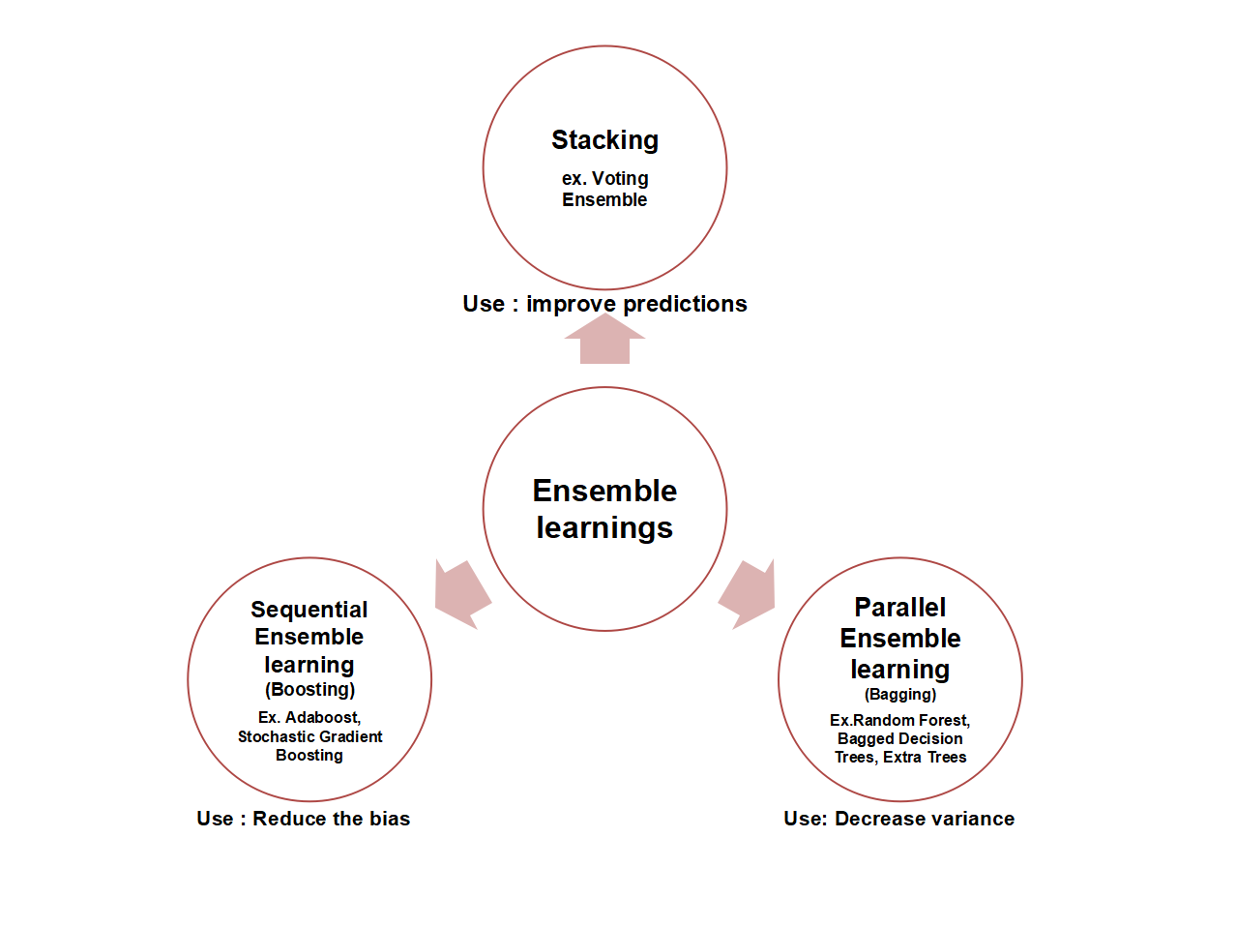

Slide 5
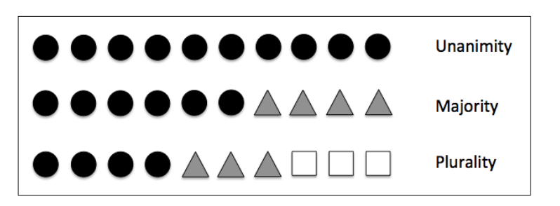
Voting

Slide 6
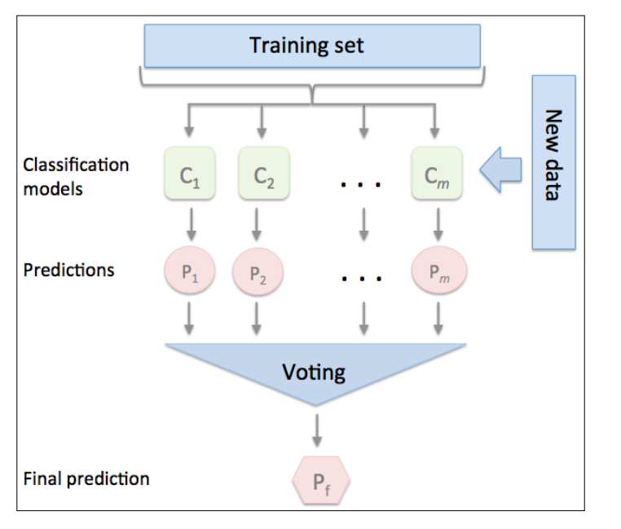
Majority Voting Classifier

Slide 7
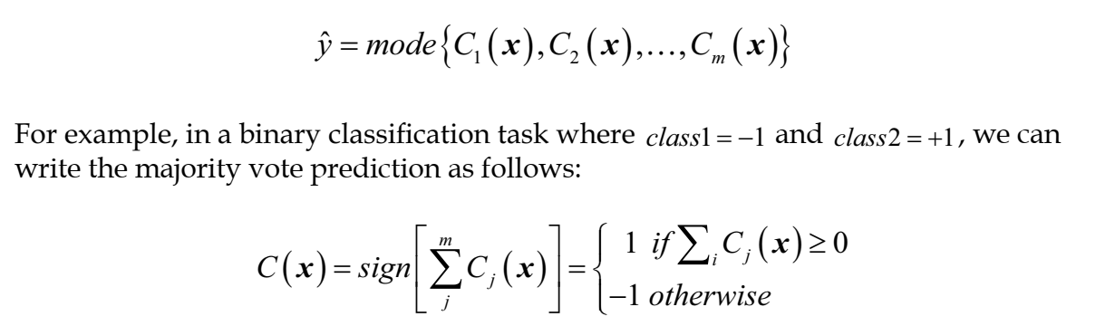
Majority Vote prediction

Slide 8
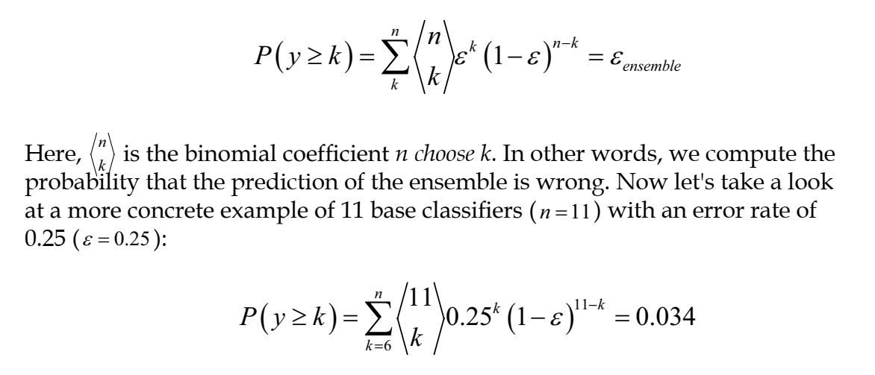
Error rate for ENSEMBLE Learner

Slide 9
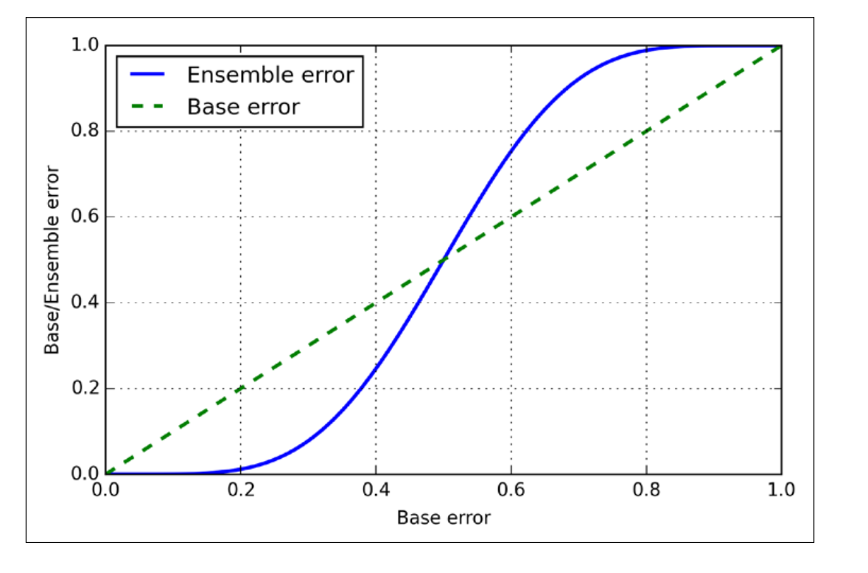
Ensemble Error V/s. Base Error

Slide 10
Bagging
Building an ensemble of classifiers from bootstrap samples [Random Samples with Replacement].

Slide 11
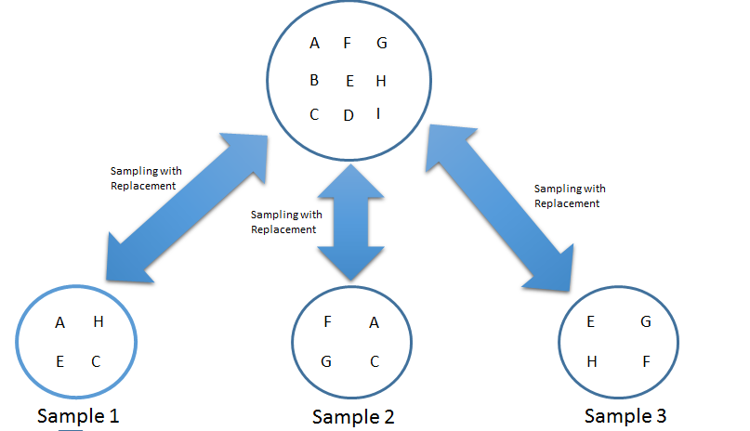
Bootstrap samples

Slide 12
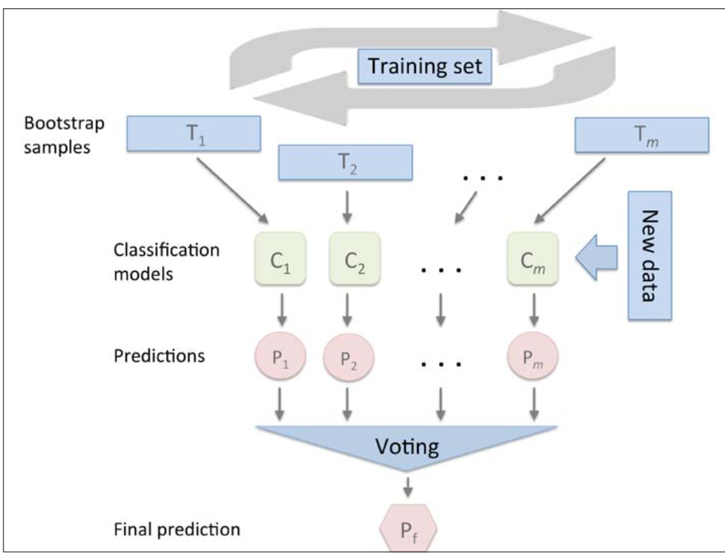

Slide 13
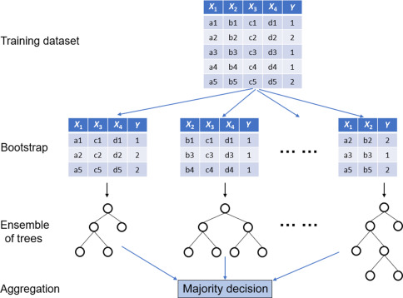
Random Forest classifier

Slide 14
Boosting
Leveraging weak learners via adaptive boosting [AdaBoost]
boosting is to focus on training samples that are hard to classify, that is, to let the weak learners subsequently learn from misclassifed training samples to improve the performance of the ensemble.

Slide 15
Boosting
In contrast to bagging, the initial formulation of boosting, the algorithm uses random subsets of training samples drawn from the training dataset without replacement.
The original boosting procedure is summarized in four key steps as follows:

Slide 16
Boosting
Draw a random subset of training samples d1 without replacement from the training set D to train a weak learner C1.
Draw second random training subset d2 without replacement from the training set and add 50 percent of the samples that were previously misclassified to train a weak learner C2.
Find the training samples d3 in the training set D on which C1 and C2 disagree to train a third weak learner C3.
Combine the weak learners C1 , C2 , and C3 via majority voting.

Slide 17
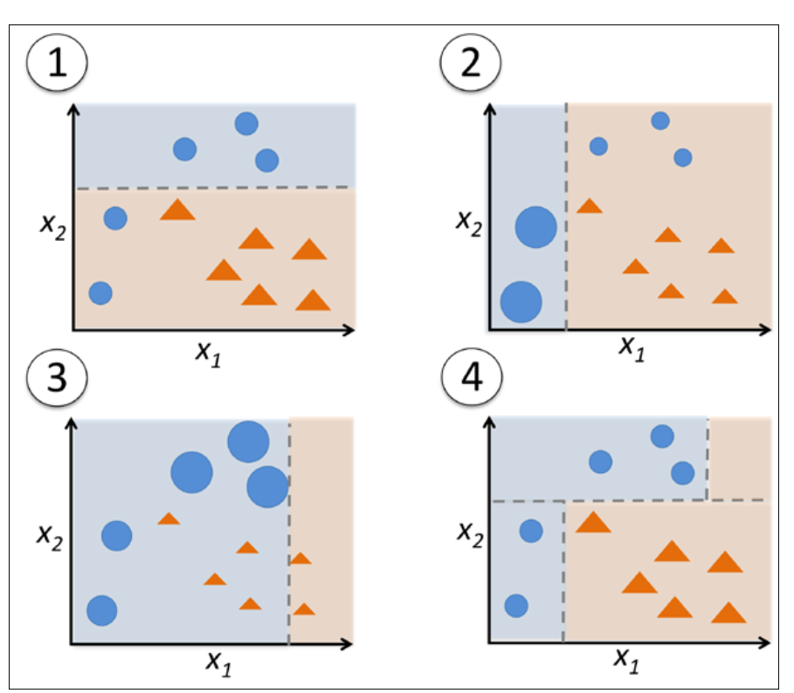

Slide 18
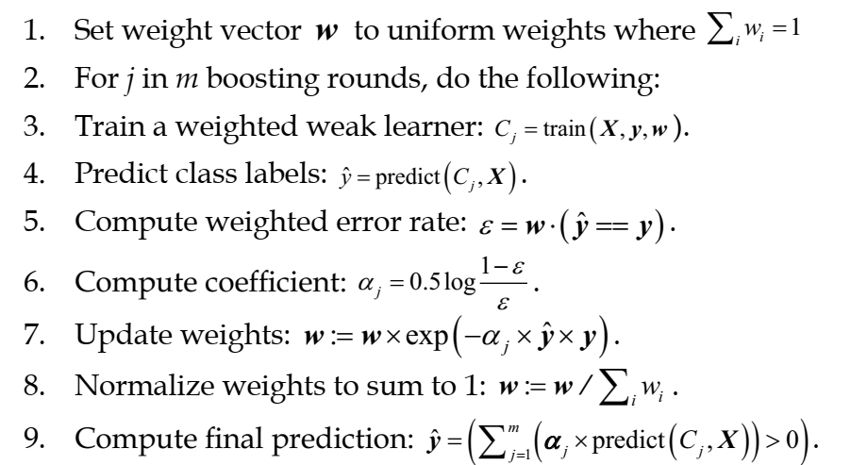
AdaBoost Classifier Algorithm

Slide 19
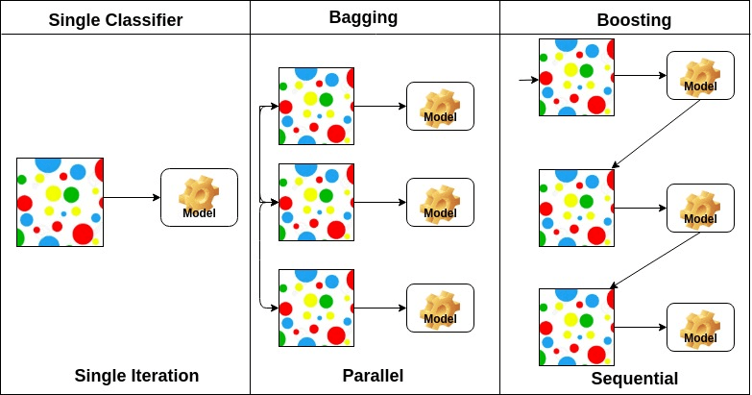
Bagging v/s. Boosting

Slide 20
Gradient Boosting
Generalization of AdaBoost as Gradient Boosting
Gradient boosting involves three elements:
A loss function to be optimized.
A weak learner to make predictions.
An additive model to add weak learners to minimize the loss function.

Slide 21
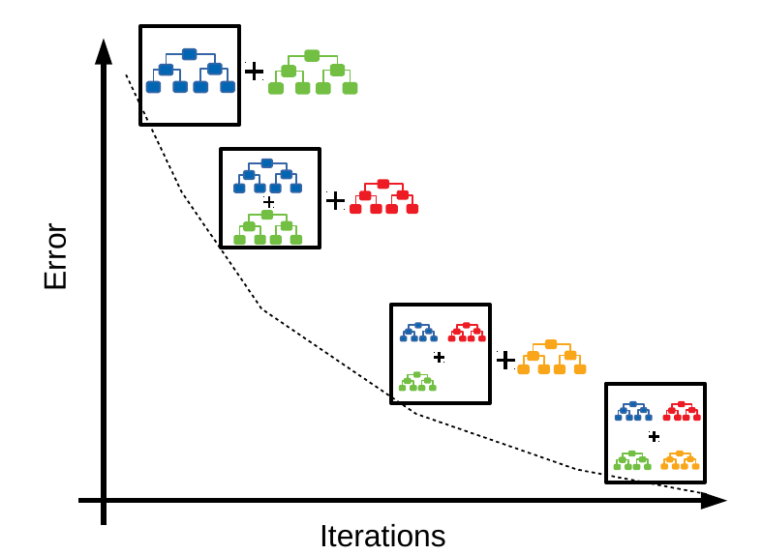


Slide 22
Other Boosting Algorithms
XGBoost
CatBoost
LIghtGBM

Slide 23


